Slide 1
Provincial Variations in Publicly-Funded Nursing Home Bed Supply in Canada: Exploring What “Matters”
Saskia Sivananthan, Malcolm Doupe, Margaret McGregor

Slide 2
Study Rationale
Population aging
While rates of institutionalization are decreasing, nursing homes are still a common venue for care of the very frail who are unable to live independently
Literature focussed on bed projections
Little work examining the factors that relate to variation in bed supply nor how the variation affects the healthcare system more generally

Slide 3
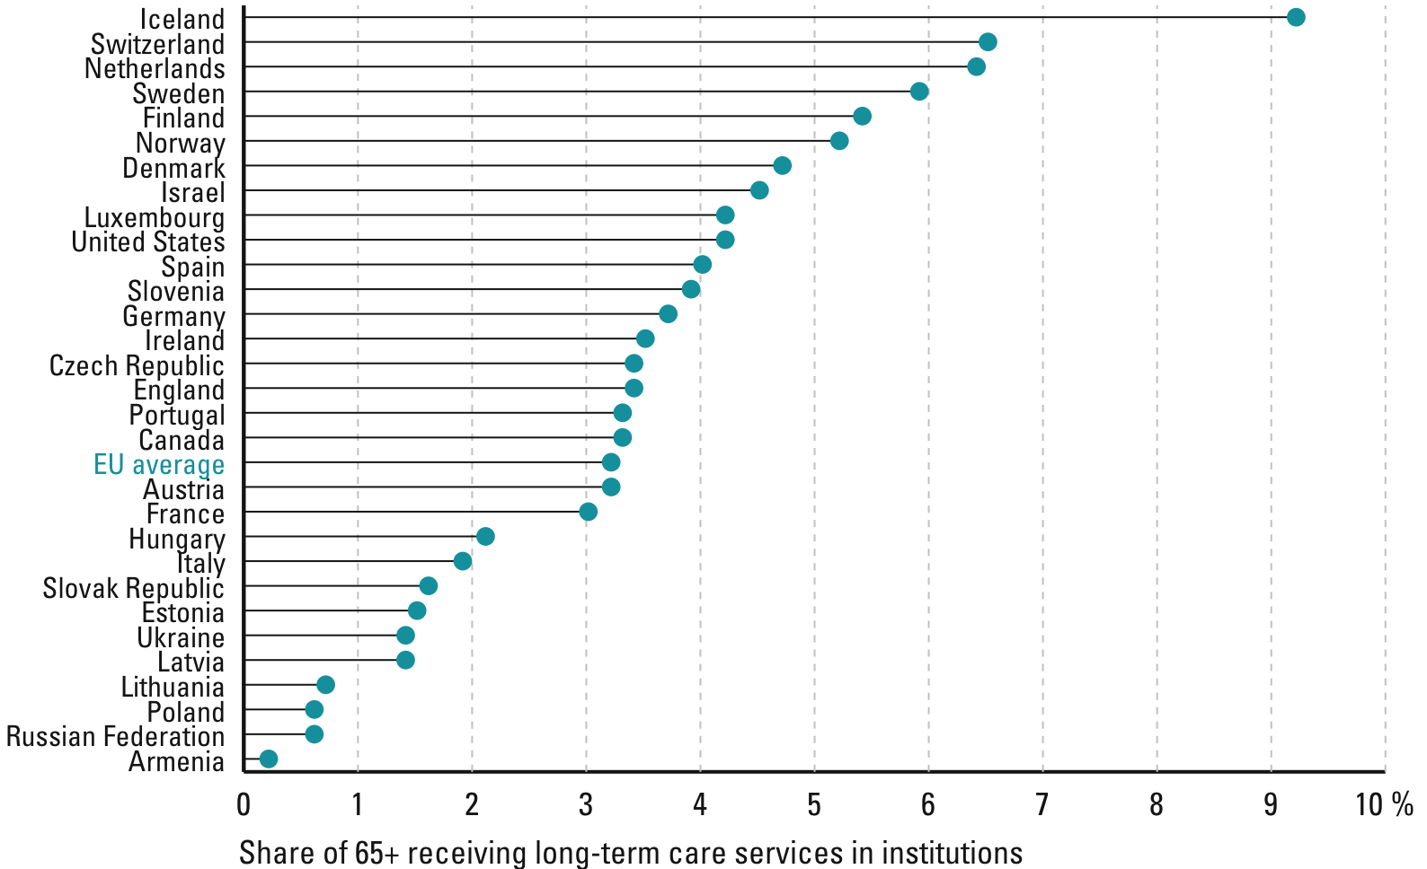
How many receive care in institutions?*
Share of older people receiving care in institutions (most recent date)
Institutional care covers only a small percentage of older people
6.5%
Source: Huber et al. (2009 forthcoming) Own calculations based on OECD, NOSOSCO , WHO, Eurostat and national sources.

Slide 4
First Study Goal
An exploration of factors related to provincial variation in Canada’s publicly funded nursing home (NH) bed supply
Are bed numbers related to variation in distribution of oldest seniors (85+)?
Is variation bed supply related to provincial wealth?
Is there an inverse relation of bed supply and provincial investment in home care?

Slide 5
Second Study Goal
Explore the extent to which publicly-funded bed supply is related to healthcare system “efficiency”
Is publicly-funded bed supply inversely related to ALC days waiting admission to a nursing home bed

Slide 6
Methods

Slide 7
Data Sources
Need for comparable data from valid sources!
Statistics Canada – Demographics, Gross Domestic Product
CUPE - (Irene Janzen, Janice Murphy) – NH bed #
CIHI - All other measures (home care*, Alternate Level of Careˆ)
Most data from 2008 - 2011
* Public-Sector Expenditures and Utilization of Home Care Services
in Canada: Exploring the Data; CIHI 2007
ˆ Obtained directly from CIHI

Slide 8
Definitions
Demographics, Publically funded NHs, Bed Supply
Focus on people 85+ years old – majority NH users from both a population and user-based perspective
Facilities funded by government to provide 24/7 care - includes respite, for profit, not-for-profit sector
Bed Supply: density (i.e., # of beds per capita).
Alternate Level of Care (ALC) Days
Hospitalized people who no longer require acute care
ALC people / days waiting for nursing home admission.

Slide 9
Analytic Approach
Descriptive reports & regression analysis
Extent that provincial variation in bed supply is related to population size 85+, wealth, etc.
Identifies provinces with > / < than average bed supply
Approach allows us to explain (or not) inter-provincial trends in nursing home bed supply.

Slide 10
Results

Slide 11
Population Distribution Across Canada - 1
Ontario & Quebec house ~ 2/3^{s} of our population, plus ~ 1/4 in BC & Alberta.
Manitoba, Saskatchewan, & Atlantic Canada house 13.5% of our population.

Slide 12
Population Distribution Across Canada - 1
This is true also for older adults, except that relatively:
Fewer live in Alberta
More live in Quebec, BC

Slide 13
Publically Funded NH Bed Supply in Canada
NH Bed supply varies across Canada, especially for people 85+ years old:
Highest in MB, Sask, Nova Scotia, PEI
Lowest in New Brunswick, BC, Alberta

Slide 14
Besides Population Size – what factors could influence NH Bed Supply?
 |  | Canada |  | BC | AB | MB | SASK | ONT | QB | New B | NFDL & L | Nova Scotia | PEI
Gross Domestic Product
 | Value per capita | $47,112 |  | $44,388 | $69,754 | $43,347 | $60,084 | $45,824 | $40,029 | $38,987 | $54,966 | $38,327 | $34,387
Home Care Expenditures (1997 dollars)
 | Value per capita | $93.6 |  | $86.8 | $91.0 | $142.2 | $82.0 | $99.8 | $79.9 | $163.4 | N/A | $116.7 | $55.5
Alternate Level of Care Days Waiting Admission to a NH
 | % of all hosp patients with 1+ ALC day, Waiting Admission to a NH | 3.2 |  | 3.5 | 2.2 | 4.3 | 4.6 | 3.2 | N/A | 2.6 | 1.2 | N/A | 4.7
 | Of all hosp days, % ALC Waiting Admission to a NH | 5.7 |  | 4.7 | 3.4 | 11.9 | 6.0 | 5.1 | N/A | 12.4 | 4.5 | N/A | 6.8

Slide 15
Population Size 85⁺ – how does it impact NH Bed Supply?
↑ than average NH bed supply based on population size
↓ than average NH bed supply based on population size

Slide 16
Population Size 85⁺ – how does it impact NH Bed Supply?

Slide 17
Population Size 85⁺ – how does it impact NH Bed Supply?
Size Doesn’t Matter (R²=.06)

Slide 18
Population Size 85⁺ – how does it impact NH Bed Density?

Slide 19
GDP & NH Bed Supply?

Slide 20
Per Capita Home Care Expenditure & NH Bed Supply?
R²=.25
R²=.27

Slide 21
Impact of NH Bed Supply on ALC Days
R²=.85

Slide 22
In Summary
 |  | Extent that NH Bed Supply is Impacted by
Provinces | NH Bed Supply | Population Size (# of 85+ year olds) | GDP | Home Care Expenditures
ALL | ↔ | ↔ | ↔ | ↔
MB, SASK, PEI, Nova Scotia, NFLD&L | ↑ | No obvious relation | No obvious relation | More HC ↓ bed supply
Ontario, AB, BC, New Brunswick | ↓ | More people ↑bed supply | No obvious relation | More HC ↓ bed supply
Greater NH Bed Supply is associated with more ALC Days waiting admission – Manitoba and NB are outliers

Slide 23
Discussion: Why is NH Supply Positively Associated with % ALC Days waiting NH Admission?

Slide 24
Discussion: “Stuff” not measured that may matter
The effect of different policy decisions by provincial governments in power
Differences in how homecare is deployed (post-op vs. longterm substitution for NH care)
Unmeasured regulatory factors?
Provincial “bed hold” policies?
Policy on NH “leeway” to refuse admission?
“First available bed” policies?
Block vs. case-mix adjusted payment systems?

