Slide 1
Do Newer Buildings Equal Better Dementia Care?
James Struthers
Trent University
May 14 2014

Slide 2
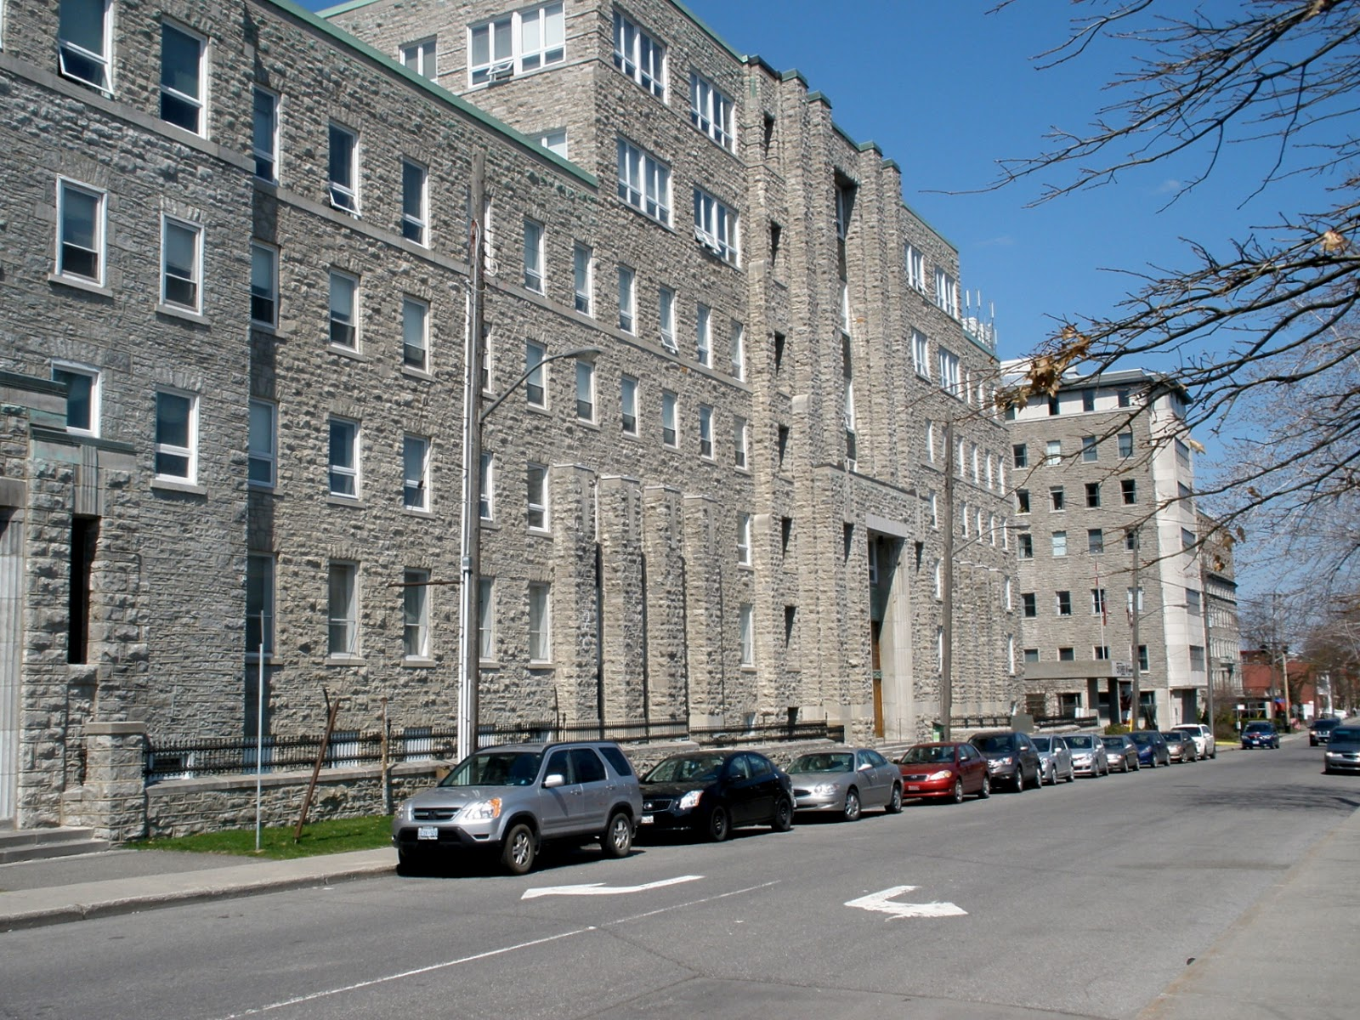
St. Jude’s (first opened 1866. Maternity ward converted to nursing home, 1980)

Slide 3
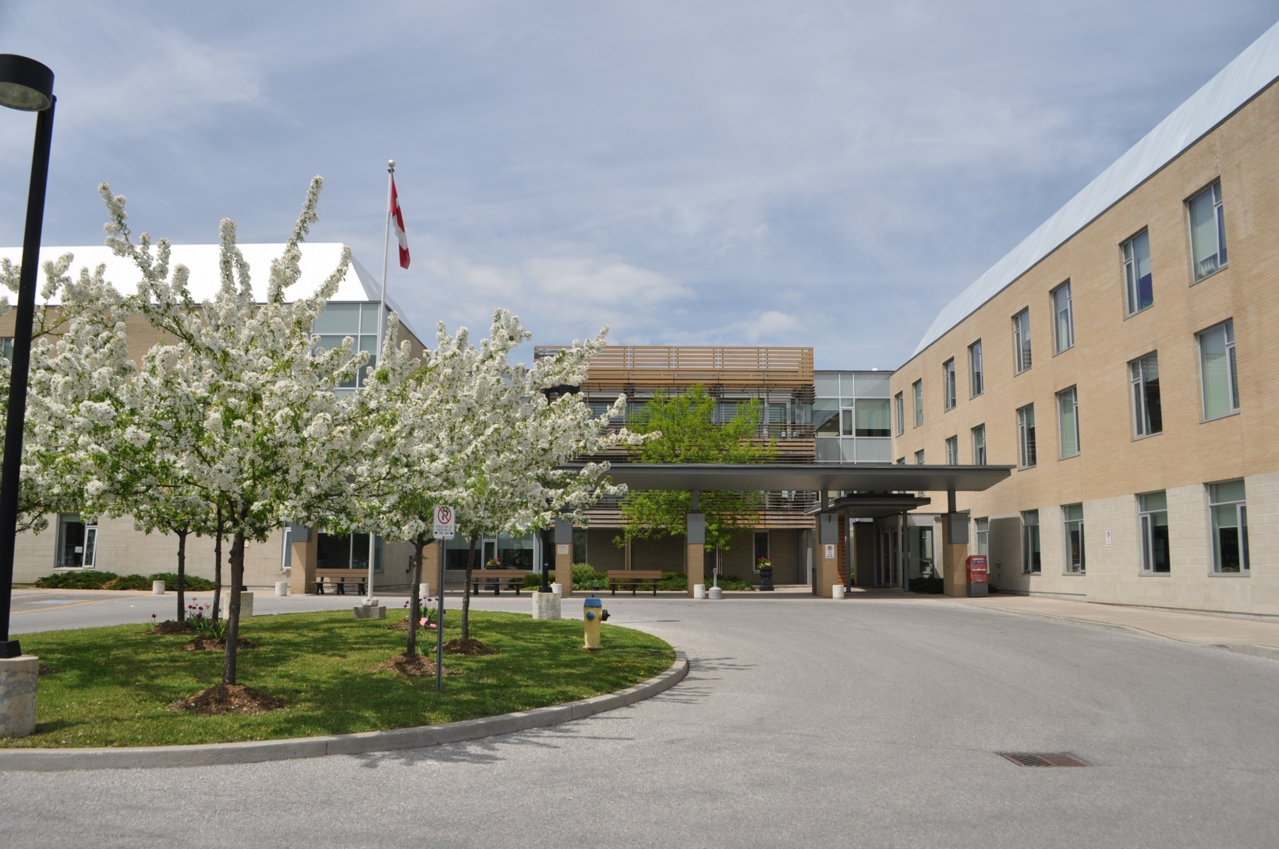
Harmony Centre (opened 2005)

Slide 4
Core research question
Why didn’t the new 2005 facility provide overwhelmingly better dementia care than the building dating from 1866?

Slide 5
Four key factors
Location
Convergence
Use of Space
History

Slide 6
Location
Old building (itself historic) was in downtown core of large city adjacent to a large farmers’ market, museums, art galleries, shopping and attractive dining areas.
Convenient for combining shopping, visiting, and excursions with family members in care.
New building was located in the suburbs, with poor transportation connections, inadequate sidewalks for walking, and a noisy, busy highway.

Slide 7
Convergence
Older building was part of larger health complex. Unionized staff were paid equivalent of hospital wages for similar work, reducing staff turnover and increasing job satisfaction.
Because of hospital connection, it had access to a larger staff pool for emergency replacements, enhancing continuity of care.

Slide 8
Use of Space
Older building had smaller attractive dining room for less cognitively impaired residents, to encourage meal time conversation.
Incorporated history of the city and the institution itself into its decor.
Newer building had one large dining room where all residents were fed, which was locked when not in use.
Poor location of nursing station blocked clear staff sight lines to resident corridors. Residents were lined up in chairs and wheelchairs in small area directly in front of the station, for much of the day. This key design flaw dominated the total environment.

Slide 9
History
Old building drew on strong sense of mission to tap a large pool of lay volunteers.
Was deeply embedded in and celebrated its historical ties to surrounding community.
New building “didn’t feel like it was part of the community.” (team member observation)
Little in its decor linked it to the city, region, or country in which it was located. Wall art was generic.

Slide 10
Conclusion
This comparison reminds us that newer buildings don’t necessarily equal better dementia care.
Homes need to reflect and be able to draw upon the community in which they are embedded.
Where they are located is crucial for good quality care and family engagement.
One key design mistake (a large nursing station with poor sight lines) can overwhelm the advantages of newness.

