Slide 1
Occupational categories in nursing homes Reflections on Norway and UK
Margrethe Kristiansen
PhD, RN
UiT, The Arctic University of Norway
Department of health and care sciences
Picture with permission from Tromsø Safari

Slide 2
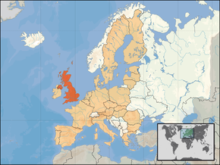
Long-term residential care in Norway and UK
Population (2013):
Norway 5 136 000
UK 64 100 000
Nursing homes (2012):
Norway 992 nursing homes with 41 732 beds.
The majority (90%) are owned and operated by the public sector
UK 4 672 nursing homes with 215 463 beds.
Over half (52%) are for- profit, owned and operated by private companies.
(Harrington et. al., forthcoming)

Slide 3
One definition of nursing home:
Nursing homes operates as medical institutions that provide accommodation and medical care to elderly individuals who can no longer obtain suitable care in their homes but who nevertheless do not need hospital care (Jakobsen F., 2005)

Slide 4
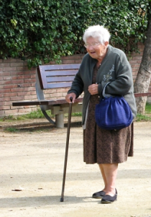
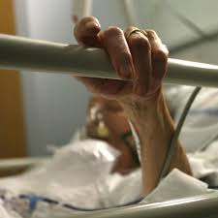
Elderly care in alteration - need for new occupational categories?
Long- term residential care has been undergoing major changes during the last decades, with following implications for the elderly care and staffing in nursing homes:
Increased medical complexity in care speaks for more skilled labor!

Slide 5
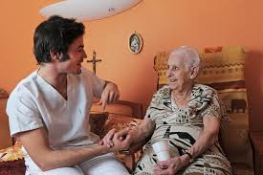
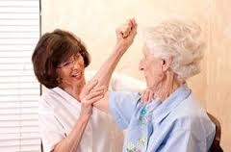
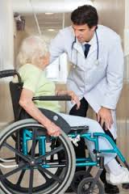
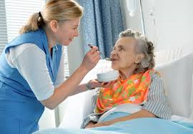
What occupational categories do we need in nursing homes, and why?
Health care assistants (HCA) and registered nurses (RN)
Pharmacist
Doctors/Geriatric specialist
Physiotherapists/ Occupational therapist
Nutrition specialist
Volunteers

Slide 6
Nursing leadership
Nursing leadership is understood as the process of influencing people to accomplish goals. Influencing others is an instrumental part of leadership and means that leaders affect others, often by inspiring, enlivening, and engaging others to participate. In this way, the process of leadership requires interaction between the leader and the followers (Kelly, 2012)

Slide 7
Promising practices
Visible nursing leadership, the key element to ensure promising practices in nursing homes

Slide 8
Summing up
We need more skilled labor through strengthen the number of existing occupational categories
We need more visible nursing leadership in long term residential care.

Slide 9
If you think you are too small to make a difference, you haven’t tried to sleep with a mosquito in the room (Dalai Lama)

Slide 10
Thank you for your attention ☺
Margrethe.kristiansen@uit.no

